Slide 1
Database
Write-Up
Sean Olejar
Mhammed Alhayek
Brian Monticello

Slide 2
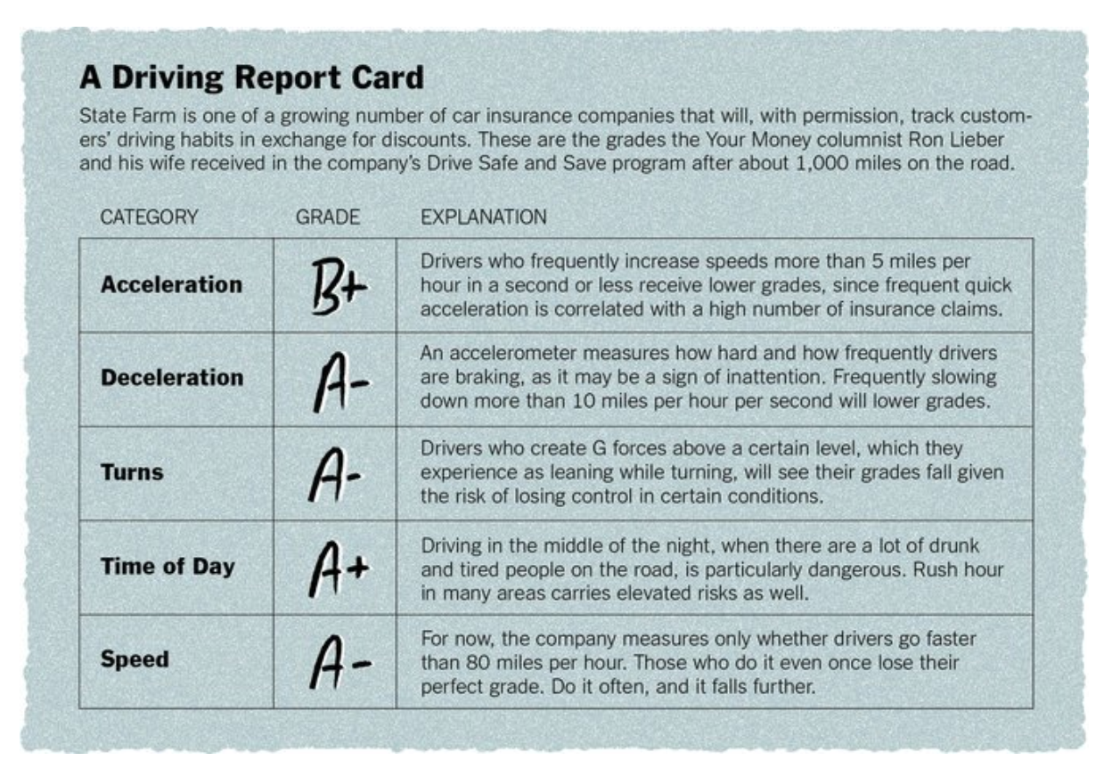
Background
Car insurance companies use internal chips to monitor driver behavior
Mutually beneficial:
Driver saves money for safe driving
Company saves money by reducing accidents and therefore claims

Slide 3

This sparked an idea...

Slide 4
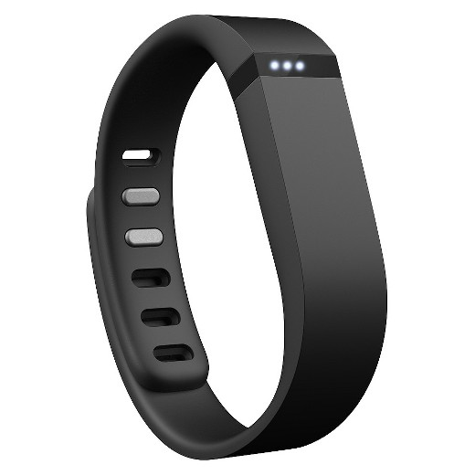
Idea
Construct a web application that will be used internally at health insurance companies.
Assume that there exists some sort of device (similar to a FitBit or Apple Watch), which allows us to accurately monitor the lifestyles of customers.
Customers will voluntarily disclose their own lifestyle habits, because the insurance company will reward a healthy lifestyle with lower premiums.

Slide 5
Our Product and Its Value
Our application will take this data about the consumers lifestyle and use it to predict likely health of the customer in the future.
Additionally, the system will determine eligibility of the customers for rate discounts.
2 major values for the insurance company:
More accurately assess premiums for their customers
Save money on medical expenses by incentivizing a healthier lifestyle.

Slide 6
Our Data
We will be simulating our own data for this project.
Data Model:
Subscriber
Info about each Customer
Relationships
Any subscribers who are in on a group plan
Policies
Info about each policy, and its rates
Medical Records
Info about all doctor/hospital visits
Health Logs
Info collected from the ‘fitbit’ device

Slide 7
